Slide 1


SMART INDIA HACKATHON 2025
Problem Statement ID – SIH 25254
Problem Statement Title- Retrieval of data from large databases of regulations, policies, projects, rules, schemes of higher education department.
Theme- Smart Education
PS Category- Software
Team ID-
Team Name(Registered on portal): CODETIVATORS

Slide 2

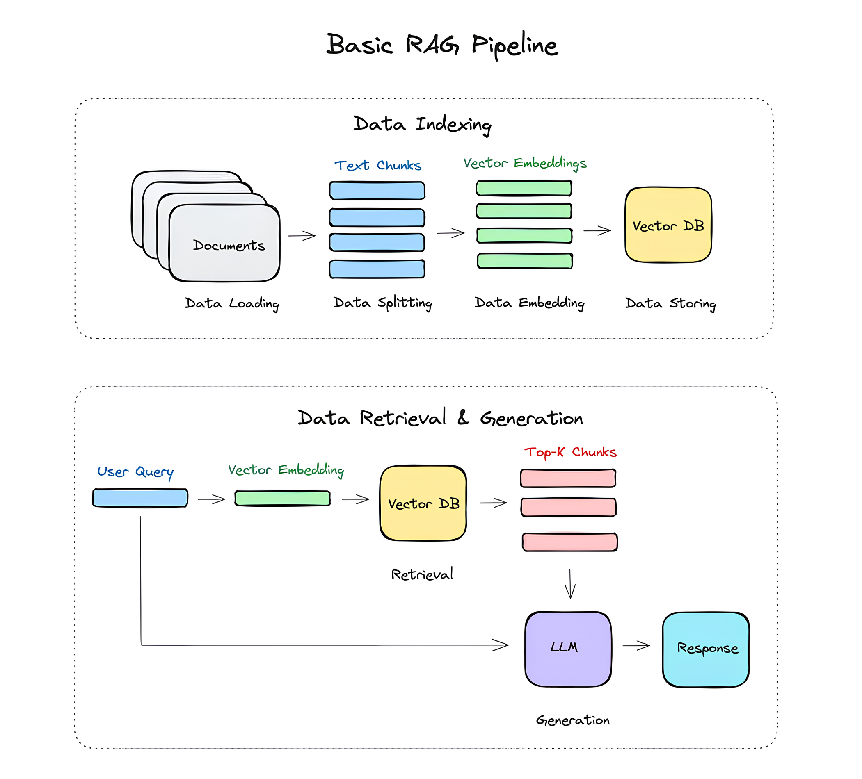
CODETIVATORS (Insight AI)
Proposed Solution
Insight AI: What is it? A secure portal for instant, accurate policy answers, featuring:
Multilingual Support: Queries & answers in regional languages.
Cross-Document Comparison: "Compare Policy A vs. Policy B".
Automated Summarization: TL;DR for long policy documents.
Policy Relationship Graph: Visual map linking schemes, policies, and acts.
Smart Financial Advisory (Policy-Aware Suggestion Engine):Helps officials and citizens identify cost-saving opportunities through government schemes.
How it Addresses the Problem: Centralizes access to information. Provides answers directly from source documents.
Innovation & Uniqueness:
Understands Intent: Knows user meaning, not just keywords.
Direct Answers: Summarized answers, not just links.
100% Verifiable: Links to the exact source paragraph for full trust.

Slide 3
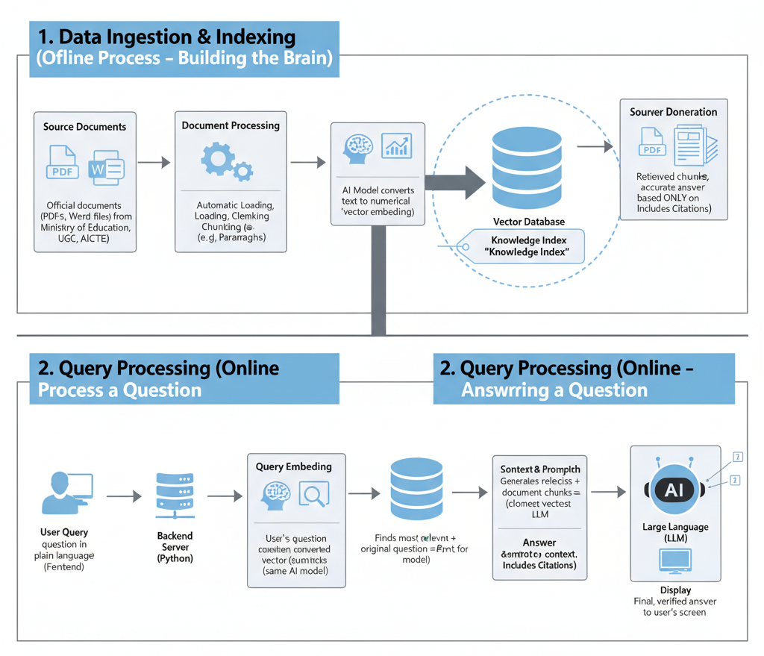



TECHNICAL APPROACH
Core Technologies:
Frontend (HTML, CSS, JS): For a responsive and accessible user interface for officials.
Backend (Python): Ideal for AI/ML integration and building a robust API.
Backend Framework: Flask OR FastAPI
Vector DB (e.g., ChromaDB): For high-speed, accurate semantic search.
Methodology (RAG):
Ingest: Feed official docs (MOE, UGC, AICTE).
Index: Create a searchable “knowledge index”.
Retrieve: Find relevant info for user query.
Generate: Create a clear answer from retrieved info.

Slide 4




FEASIBILITY AND VIABILITY
Existing System | Purpose | Limitation | How Yours Improves
Bhashini / Anuvadini | Multilingual translation | No retrieval or summarization | Insight AI adds semantic search + context
RTI Portal | Provides info upon request | Manual, time-consuming | Insight AI provides instant verified answers
India Code Portal | Legal database | Not AI-based; no intent understanding | Insight AI provides intelligent Q&A + summaries
PolicyDB (ResearchGate project) | Stores policies globally | Not specific to Indian higher education | Ours is domain-specific & official-source verified
Feasibility:
Technical: High; RAG is a mature and well-documented AI architecture.
Data: High; All source documents from MoE, UGC, and AICTE are publicly available.
Analysis of Similar Systems:
Citizen-Facing Chatbots: These answer simple public FAQs.
Our System's Difference: A sophisticated internal tool for officials, handling complex queries by synthesizing information from technical documents.
Future Scope: Advanced Capabilities:
Timeline Analysis: Visualize policy changes over time.
Proactive Alerts: Notifications on document updates for subscribed topics.
Role-Based Access: Secure access based on an
official's role.
Frontend | Backend | LLM | Embedding Model | Vector Database | OCR Engine | Translation | Hosting
HTML + CSS + JS | FastAPI + Python 3.11 | [SPECIFY: GPT-4 / Llama / Gemini] | sentence-transformers (all-MiniLM-L6-v2) | ChromaDB | Tesseract + PaddleOCR | Bhashini API / Google Translate API | AWS / Azure / On-Premise
Environmental/Social Impact
Paperless queries save trees annually
Reduces travel for document verification (Green initiative)

Slide 5
IMPACT AND BENEFITS
For Students & Universities:
For Officials
Streamlines scholarship verification.
Streamlines approval for courses & grants.
Result: Facilitates student aid and university growth.
Reduces time spent on document search.
Supports informed, confident, and consistent decisions.
For the Public:
Contributes to an efficient education system.
Promotes transparency & consistent policy application.
Result: Supports positive educational outcomes.
Potential Challenges & Solutions:
1.Challenge: Complex documents (scans, formats).
Solution: Use advanced OCR for text extraction.
2.Challenge: Keeping data current.
Solution: Automated web crawlers for new document ingestion.
3.Challenge: What if AI gives wrong answer?
Solution: Human-in-the-loop verification for critical decisions + Confidence score display
4.Challenge: Multilingual accuracy issues.
Solution: Domain-specific fine-tuning on translated policy corpus
5.Challenge: User adoption resistance.
Solution: Mandatory training + Gamification (leaderboard for most queries)
Risk | Probability | Mitigation
Data quality issues | High | Manual verification layer
LLM hallucinations | Medium | Always show source citations
Slow adoption | Medium | Training workshops
Outdated documents | High | Daily automated crawlers
Security breaches | Low | RBAC + Audit logs

Slide 6

RESEARCH AND REFERENCES
References
Primary Data Sources:
Ministry of Education, Government of India. Retrieved from https://www.education.gov.in
University Grants Commission (UGC), India. Retrieved from www.ugc.ac.in
All India Council for Technical Education (AICTE). Retrieved from https://www.aicte-india.org
Key Reference Documents:
Ministry of Education. (2020). National Education Policy 2020. Government of India.
All India Council for Technical Education. Approval Process Handbook (Latest Edition).
Ministry of Education. Rashtriya Uchchatar Shiksha Abhiyan (RUSA) - Master Content & Guidelines.
Julija, D. (2021, August 5). What is Retrieval-Augmented Generation (RAG)? Medium. https://medium.com/@drjulija/what-is-retrieval-augmented-generation-rag-938e4f6e03d1
Our SIH Mentor :
Dr. Akash Mecwan(Electronics and Communication Engineering Department)
Project Documentation and Prototype Video: CLICK HERE

